Slide 1
Predicting CA Vaccination Rates
By Matt Cooley

Slide 2
Background
There have been several high-profile measles outbreaks recently.
This is in-conjunction with a newfound skepticism toward the safety and efficacy of vaccines.
Even small changes in the vaccination rate can have a big impact in the effect of ”herd immunity”.
Notes:
New York just banned unvaccinated individuals from public spaces.

Slide 3
It takes a Herd
Notes:
Measles in Particular is highly contagious, requiring a high vaccination rate (~95%)

Slide 4
Questions/Hypothesis
What does the distribution of the vaccination rates look like across California?
Demographic data can predict the rates of vaccination.
Income
Education
Insured rate
Population

Slide 5
Meet the data
CA Kindergarten Immunization records (Kaggle)
Number of students
Number of students with vaccination records
Records from 2000-2015 (used records from 2010-2014 for this analysis)
2010-2014 American Community Survey (5-year estimates)
Estimates performed by (CA Dept. of Finance)
Calculated vaccination rate from school population and the number of vaccination exemptions per school.
Notes:
5 years of vaccination records were combined.
Few students repeat Kindergarten

Slide 6
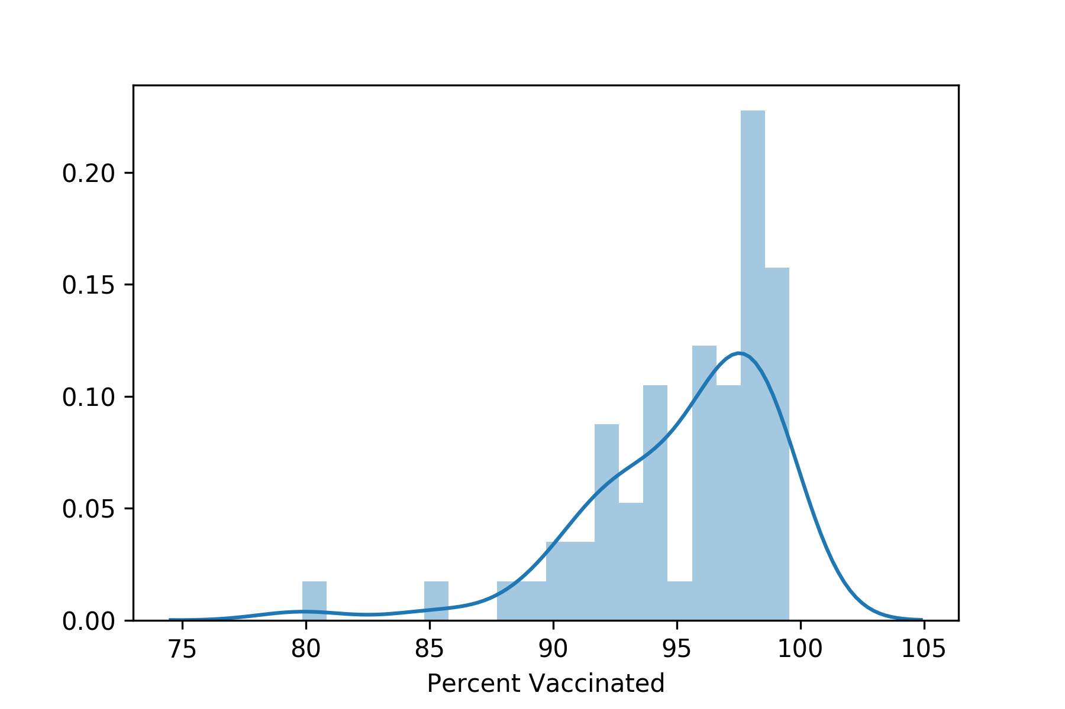
Vaccination Rate Distribution
Mean: 95.3
Median: 96.3
Std Dev: 3.77
Min: 79.9%
Max: 99.5%
Notes:
- Here we see that the vaccination rate is pretty good.
Highly contagious diseases can be as high as 95%
Also because of the the ease of transportation, any communities that are low can have an impact.

Slide 7
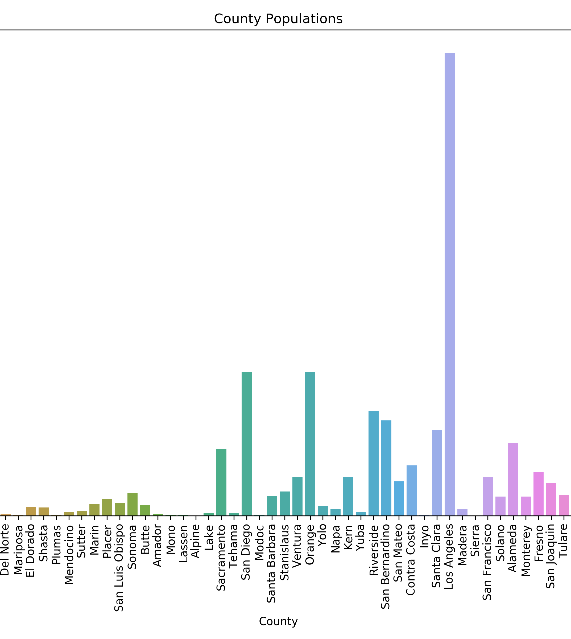
County Populations
Large variance in populations
Notes:
Should probably break down at a city level.

Slide 8
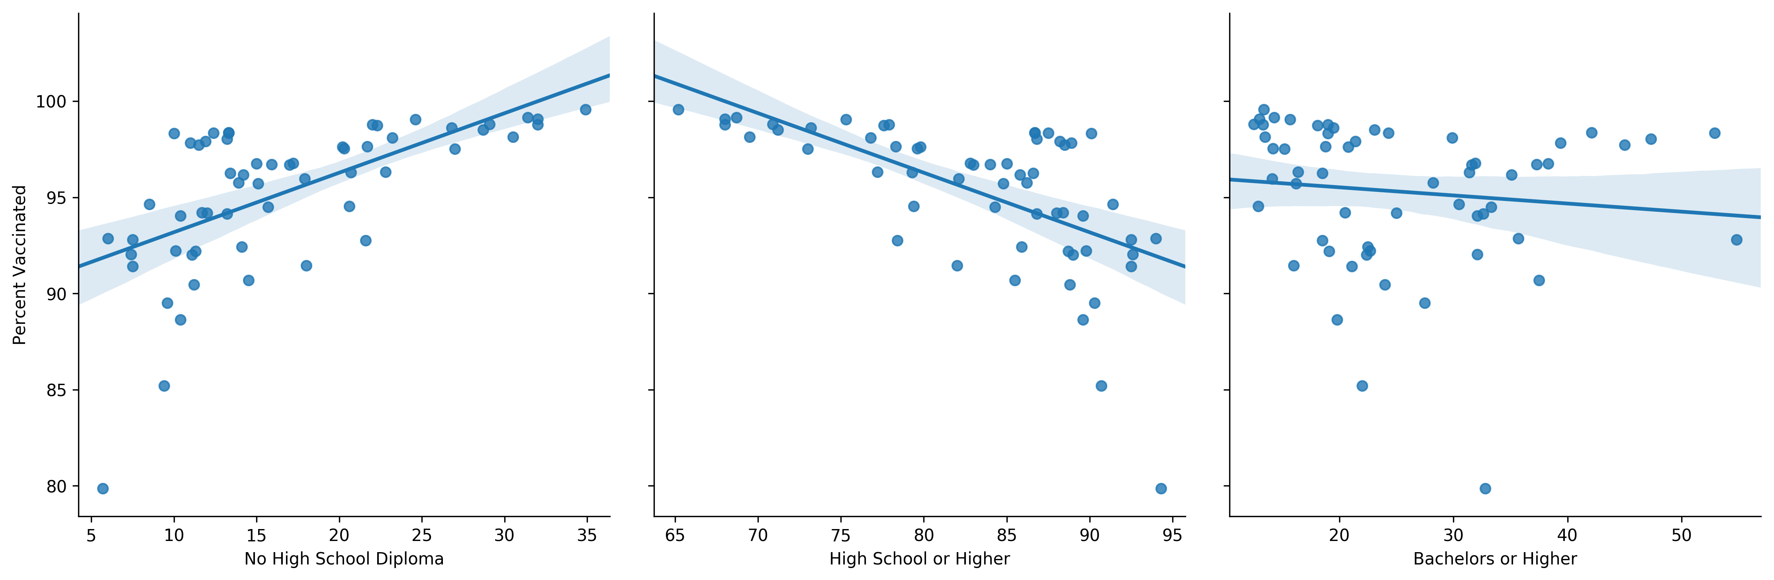
Education Level
There appears to be a correlation between little to no education and vaccination rates.
Notes:
No other cutoff seemed to have a correlation.
High School or higher
Bachelors or higher
Grad or higher
Individual groups had no correlation either

Slide 9
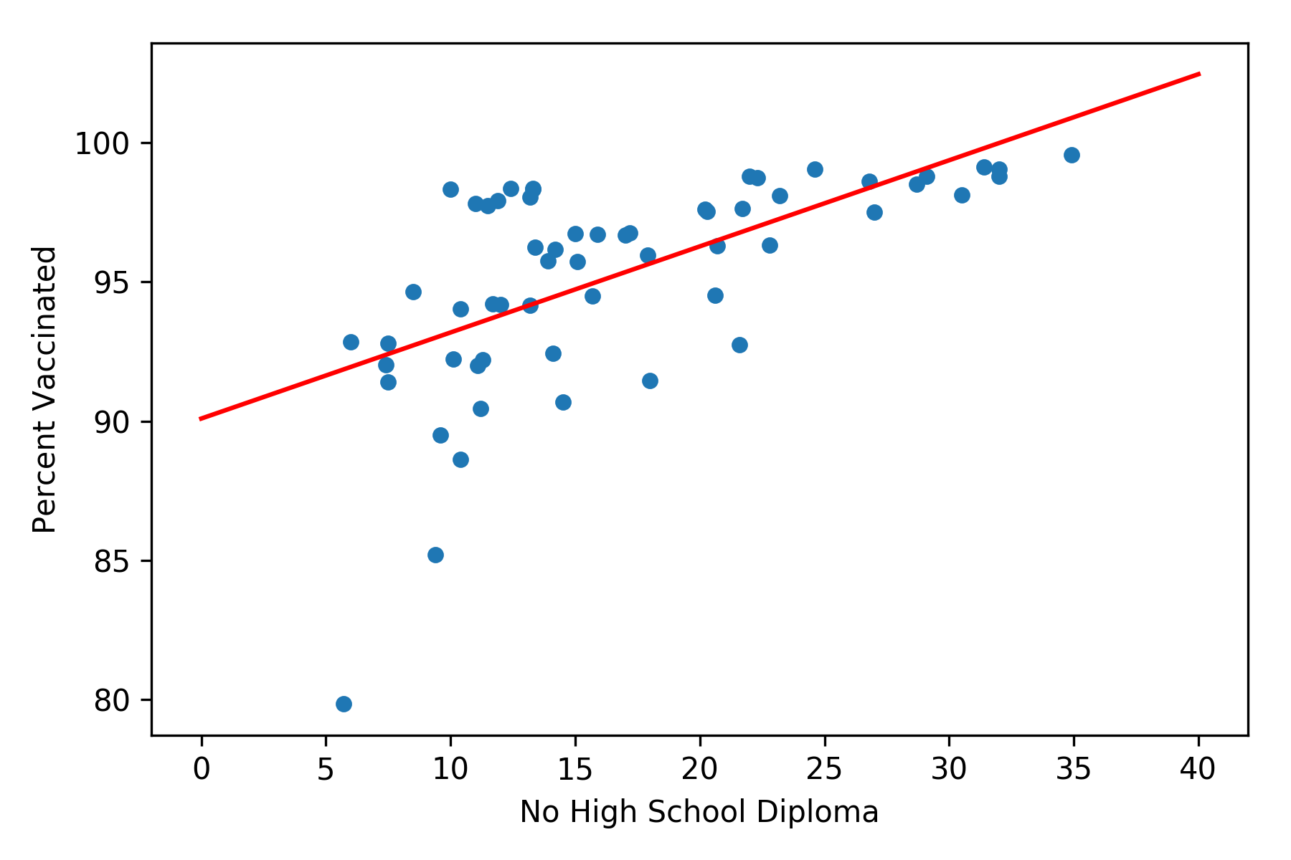
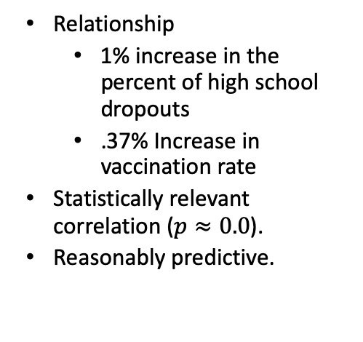
No High School Diploma
Relationship
1% increase in the percent of high school dropouts
.37% Increase in vaccination rate
Statistically relevant correlation ($p≈0.0$).
Reasonably predictive.
Notes:
- The fact that the p-value is SO low, could indicate an artifact in the data or some other issue with my assumptions.
- Further analysis and a larger sample are needed to explore this further.

Slide 10
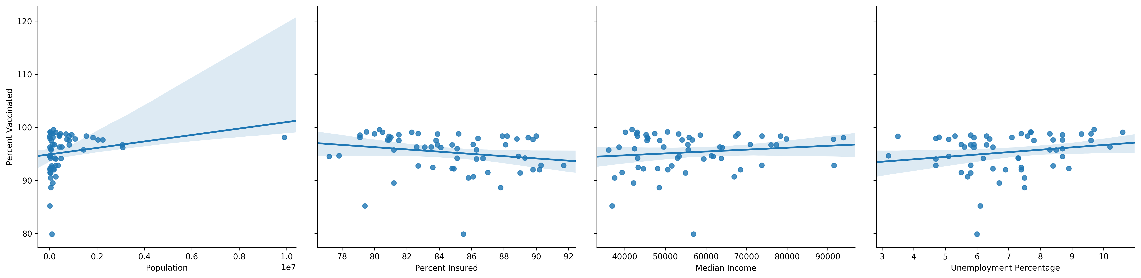
No correlation
In particular I was surprised that the uninsured rate had no noticeable correlation with the vaccination rate.
Population is problematic due to the high variance.
Income and employment also showed no correlation
Notes:
There seems to be something of a trend for percent insured, but not significant.
Maybe looking by city would help?

Slide 11
Conclusions
There appears to be a connection between education levels and vaccination rates.
There are likely other indicators that I did not test in this experiment that could add predictive value to my model.

Slide 12
Next Steps
Disaggregate data by city
Look for other variables to improve model such as:
Religion
Ethnicity
Number of members in households

